Slide 1
Mobile Application Development
Lecture 12

Slide 2
Introduction to Ionic Components
Ionic Framework itself provides many already built-in UI components.
Anything you will need in your mobile app, Ionic Framework has got you covered.
We used some of these components such as ion-item , ion-card, ion-alert. Lets look at some more useful components that we can use.
Notes:
First of all, we need to understand what Parent, Child, and Sibling components are.

Slide 3
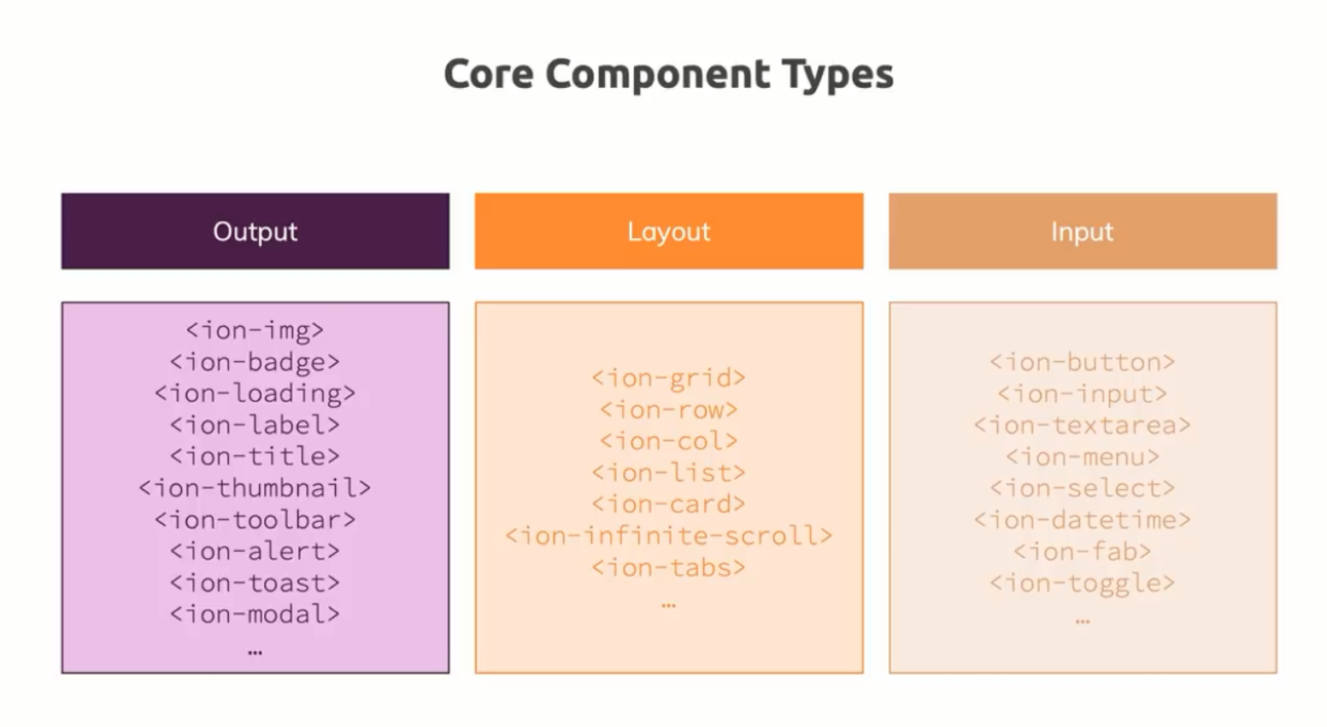
Introduction to Ionic Components
Notes:
First of all, we need to understand what Parent, Child, and Sibling components are.

Slide 4
Introduction to Ionic Components
We will look at the documentation at https://ionicframework.com/docs and go through some of the common ones we see in mobile apps.
Lets create Signup page for a student.
Notes:
First of all, we need to understand what Parent, Child, and Sibling components are.

Slide 5
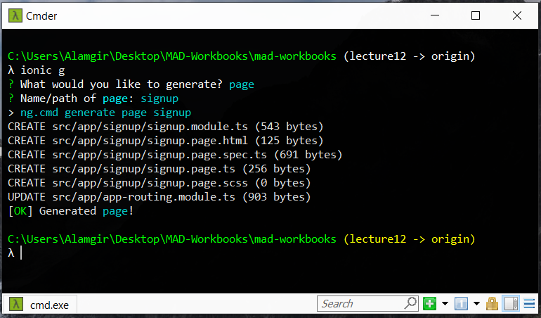
Introduction to Ionic Components
Notes:
First of all, we need to understand what Parent, Child, and Sibling components are.

Slide 6
Introduction to Ionic Components
We need name, email, date of birth, address, city, for signup. We will be using different ionic components for this. And we will setup all of it using Reactive Forms.
We will also take a look at styling our components using built-in ionic utilities such as CSS utilities (https://ionicframework.com/docs/layout/css-utilities)
Notes:
First of all, we need to understand what Parent, Child, and Sibling components are.

Slide 7
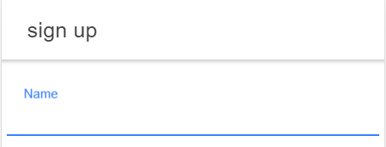
Introduction to Ionic Components
Name – We will use ion-input
<ion-item>
<ion-label position="floating">Name</ion-label>
<ion-input></ion-input>
</ion-item>
Email – again same
Address – for address, we will use <ion-text-area>
Notes:
First of all, we need to understand what Parent, Child, and Sibling components are.

Slide 8
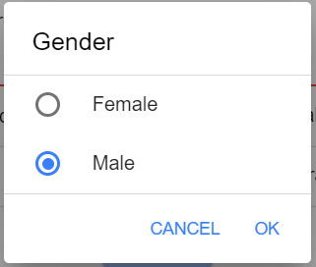
Introduction to Ionic Components
Gender – We will need a dropdown for this so we will use <ion-select>
<ion-item>
<ion-label>Gender</ion-label>
<ion-select formControlName="gender" placeholder="Select One">
<ion-select-option value="f">Female</ion-select-option>
<ion-select-option value="m">Male</ion-select-option>
</ion-select>
</ion-item>
Notes:
First of all, we need to understand what Parent, Child, and Sibling components are.

Slide 9
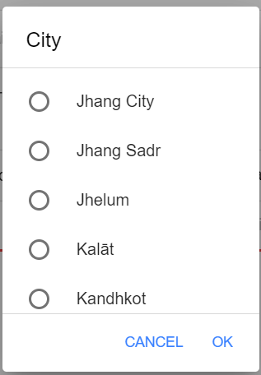
Introduction to Ionic Components
Cities– We will again need <ion-select>. But because there will be plenty of cities, we can just type them in html. We will use *ngFor and use a JSON.
<ion-item>
<ion-label>City</ion-label>
<ion-select formControlName="city" placeholder=“Select City">
<ion-select-option *ngFor="let city of cities" [value]="city.city">{{city?.city}}</ion-select-option>
</ion-select>
</ion-item>
Notes:
First of all, we need to understand what Parent, Child, and Sibling components are.

Slide 10
people will forget what you said, people will forget what you did, but people will never forget how you made them feel. ~ Maya Angelou

Slide 11
Introduction to Ionic Components
Cities– We will again need <ion-select>. But because there will be plenty of cities, we can just type them in html. We will use *ngFor and use a JSON.
<ion-item>
<ion-label>City</ion-label>
<ion-select formControlName="city" placeholder=“Select City">
<ion-select-option *ngFor="let city of cities" [value]="city.city">{{city?.city}}</ion-select-option>
</ion-select>
</ion-item>
Notes:
First of all, we need to understand what Parent, Child, and Sibling components are.

Slide 12
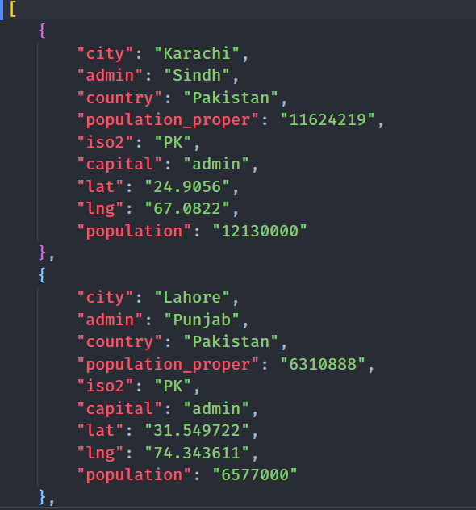
Introduction to Ionic Components
Cities– I have a pk.json file which has cities list of pakistan.
In order to use it in TypeScript, I had to add one line to tsconfig.json
"compilerOptions": {
"resolveJsonModule": true,
}
Notes:
First of all, we need to understand what Parent, Child, and Sibling components are.

Slide 13
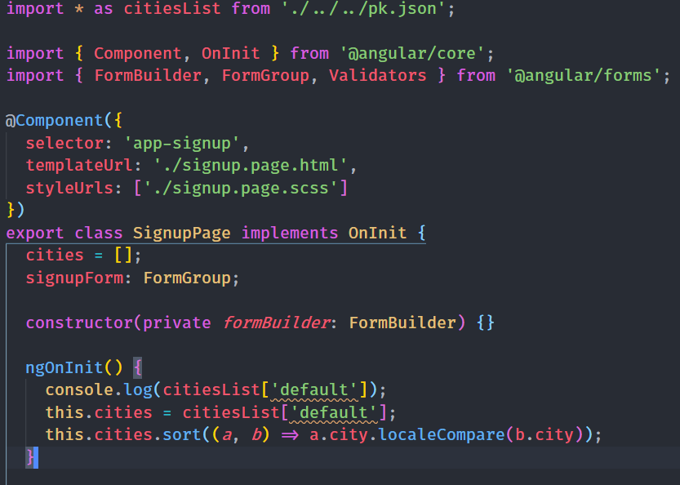
Introduction to Ionic Components
Cities– we will import it like this
import * as citiesList from './../../pk.json';
And in ngOnInit
this.cities = citiesList['default'];
Then we can sort alphabetically using
this.cities.sort((a, b) => a.city.localeCompare(b.city));
Notes:
First of all, we need to understand what Parent, Child, and Sibling components are.

Slide 14
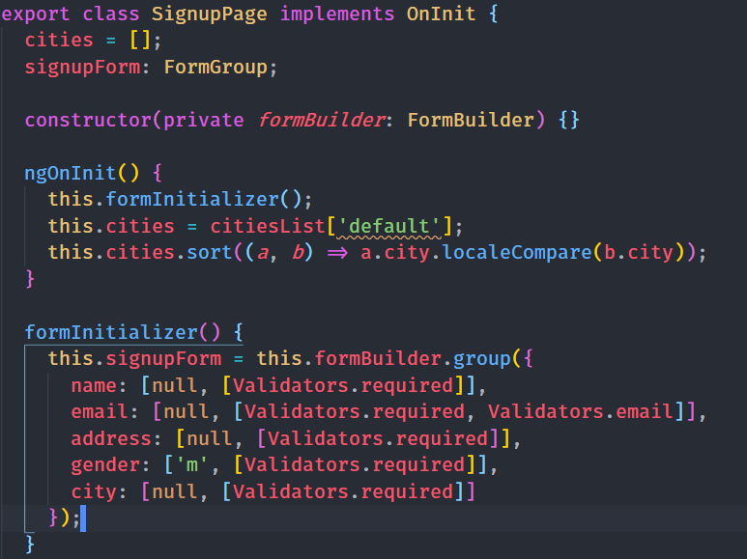
Introduction to Ionic Components
Now in order to save all this profile data, we will use Reactive Forms.
In TypeScript, we create a formInitializer() function, and execute it on ngOnInit.
We add appropriate validations
Notes:
First of all, we need to understand what Parent, Child, and Sibling components are.

Slide 15
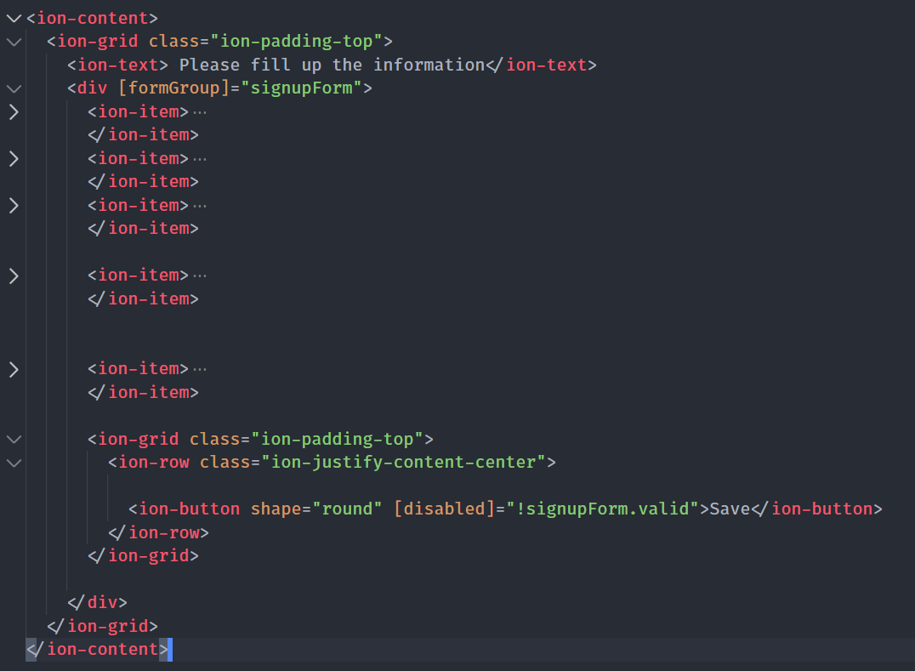
Introduction to Ionic Components
In Html, we add a formGroup with the name signupForm
we added a save button at the button using <ion-button>
take a look at that disabled property.
Notes:
First of all, we need to understand what Parent, Child, and Sibling components are.

Slide 16
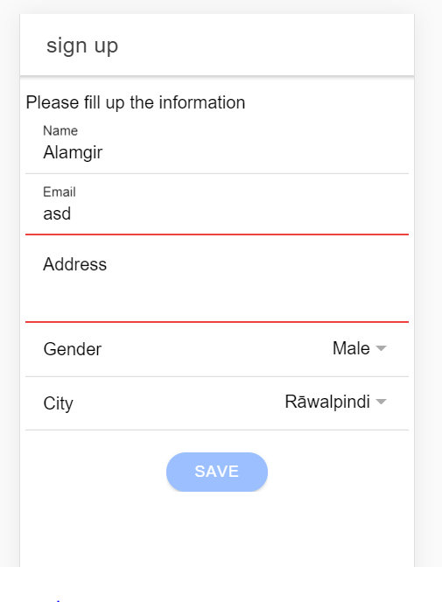
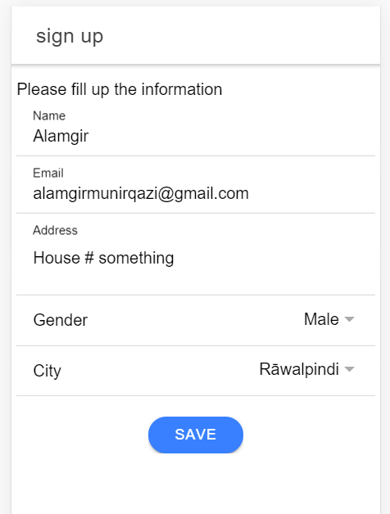
Introduction to Ionic Components
Here’s how it looks like
Notes:
First of all, we need to understand what Parent, Child, and Sibling components are.

Slide 17
Introduction to Ionic Components
There are other ionic components that you would have to use depending on your requirement
e.g ion-loading, ion-radio, ion-refresher, ion-skeleton-text, ion-modal, ion-fab etc.
Take a look at https://ionicframework.com/docs/api
Notes:
First of all, we need to understand what Parent, Child, and Sibling components are.

